Slide 1
Instructor Notes
Reveal or create an Instructor Intro slide
Reveal or create slides that allow the students to introduce themselves
One repo or many?

Slide 2
Introduction to Chef
Cookbook development workflow

Slide 3
Prerequisites
Have an ssh client
Have a good text editor (Atom, Sublime, vim, emacs)
Git & GitHub Account (Optional)

Slide 4
Introductions

Slide 5


Instructor
Nathen Harvey
Community Director, Chef
Co-host of the Food Fight Show

Slide 6

Instructor
John Martin
CHEF Solutions Engineer
7th year @ SCALE

Slide 7
Lab Assistants
Some other Chef’s in the room
YOU ☺
Introduce yourselves

Slide 8
Course Objectives & Style

Slide 9
Course Objectives
After completing this course you will be able to:
Automate common infrastructure tasks with Chef
Verify your automation code BEFORE it runs in production
Describe some of Chef’s tools
Apply Chef’s primitives to solve your problems

Slide 10
Learning Chef
You bring the domain expertise about your business and problems
Chef provides a framework for solving those problems
Our job is to work together to help you express solutions to your problems with Chef

Slide 11
Chef is a Language
Learning Chef is like learning the basics of a language
80% fluency reached quickly
20% just takes practice
The best way to LEARN Chef is to USE Chef

Slide 12
Training is a discussion
Lots of hands on labs
Lots of typing
Ask questions when they come to you
Ask for help when you need it
Help each other
We will troubleshoot and fix bugs on the spot

Slide 13
Just an Introduction
Today is just an Introduction to testing your automation code with Chef and it’s tools
We’ll cover lots of topics but won’t go too deep on any of them
Any discussion that takes us too far off the path will be captured
We will return to these topics as time permits

Slide 14
Class Logistics
Follow along as we go:
github.com/tekbuddha/chef-scale-2015

Slide 15
Class Logistics
Streaming LIVE to YouTube via Google+ Hangout
Slides in the GitHub repository
Code will be added to GitHub as we go
But…we have a social contract…
Notes:
The social contract includes:
No working ahead
Copy-n-paste only if typing didn’t work out properly for you
Be patient, courteous, etc.
Follow the code-of-conduct for the conference

Slide 16
Agenda

Slide 17
Agenda
Overview of Chef
Resources
Describing Policies
A Sandbox for testing
Verifying node state
Even faster feedback
Clean code
Wrap Up

Slide 18
Breaks!
We will take breaks as often as we need them
We will break for lunch
Notes:
What are the prescribed break times?
Is lunch provided? When?

Slide 19
Prerequisites
Have an ssh client
Have a good text editor (Atom, Sublime, vim, emacs)
Git & GitHub Account (Optional)
Notes:
Option pre-requisite - Install Chef DK - http://downloads.chef.io/chef-dk/

Slide 20
Slides, Code, Questions, etc.
github.com/tekbuddha/chef-scale-2015
Slides are available now (subject to change)
Code will be added as we go

Slide 21
Overview of Chef
Policy-based Infrastructure as Code
Notes:
In 10 slides or less. Please ask questions!

Slide 22

Benefits of Automation
Notes:
TODO: Add speaker notes

Slide 23
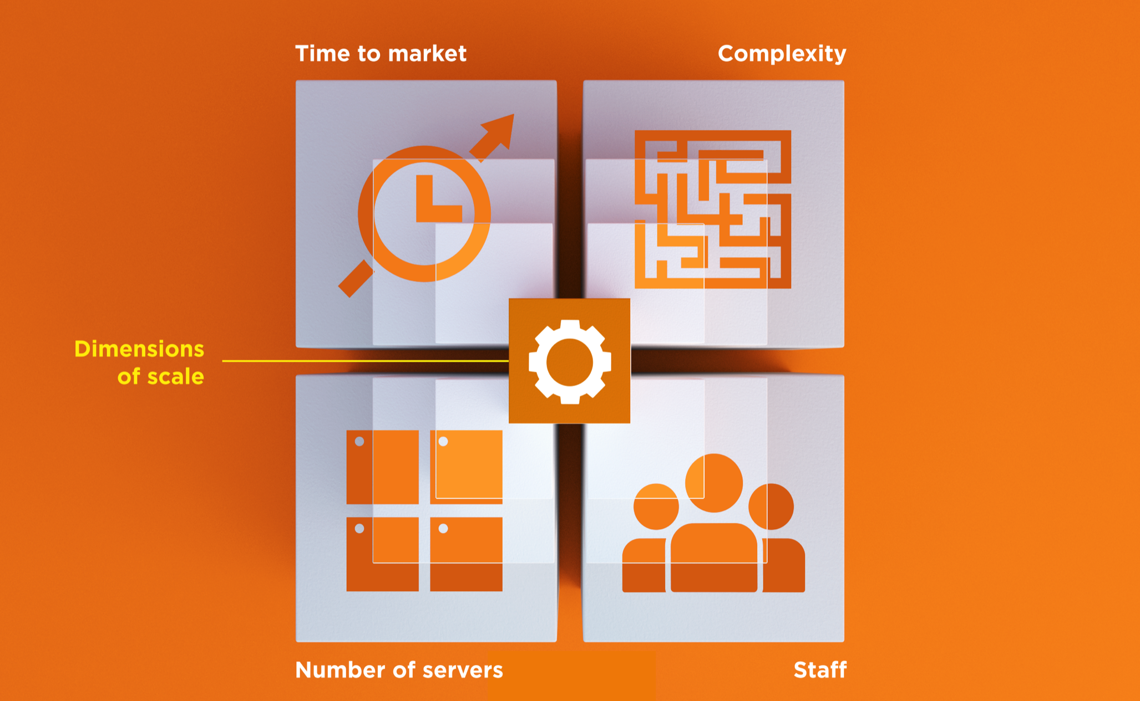
Dimensions of Scale
Notes:
Scale has several dimensions.
Size – Number of physical and virtual servers deployed
Complexity – Sophistication of the technology stack and the nature or service interdependencies
People – Number of people required to maintain and support infrastructure
Agility and Speed – time-to market and ability to respond quickly as business need change.
Web-scale IT also means web-speed IT. Business agility is a central component.

Slide 24
Automation Platform
Creates a dependable view of your entire network’s state.
Can handle complex dependencies among the nodes of your network.
Is fault tolerant.
Is secure.
Can handle multiple platforms
Can manage cloud resources
Provides a foundation for innovation
Notes:
TODO: Add pictures, break this

Slide 25
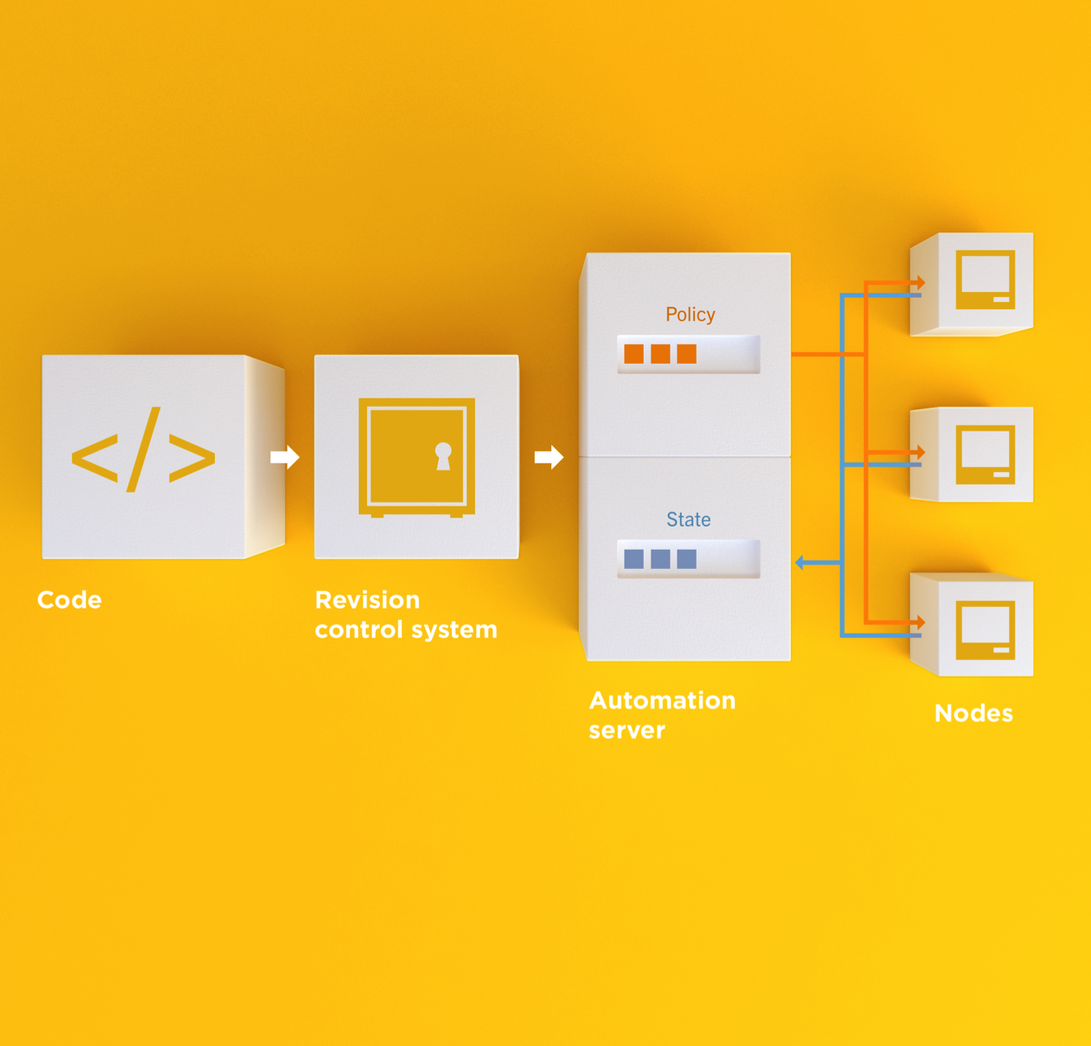
Infrastructure as Code
Programmatically provision and configure components
Notes:
Use the Chef framework and Chef programming language to define the components of your infrastructure. This allows you to capture and document the shape of your infrastructure in a consistent way.

Slide 26
Infrastructure as Code
Treat like any other code base
Notes:
Treat this like any other code base:
Store the code in a version control system.
Add automated tests to the code.
Refactor the code over time.
Build and version software artifacts (e.g. packages)
The code is executable documentation.
Store the code in a version control system.

Slide 27
Infrastructure as Code
Reconstruct business from code repository, data backup, and compute resources
Notes:
With your infrastructure now fully captured in code, you are now able to rebuild your entire business, well, at least all of your business’s applications, with your code repository, a backup of your data, and compute resources, be they bare metal, virtual machines, or cloud instances.

Slide 28
Infrastructure as Code
Programmatically provision and configure components
Treat like any other code base
Reconstruct business from code repository, data backup, and compute resources
Notes:
Stop for a minute and think about what we're saying here. Think about how freeing this can be. The next configuration change you need to make in production starts with a commit to your version control system. You can re-provision your infrastructure with another service provider; move from the data center to the clould and back again.How will this impact the way you run operations in your organization? What questions do you have?

Slide 29
Policy-based
You capture the policy for your infrastructure in code
Chef ensures each node in your infrastructure complies with the policy
Notes:
TODO: Pictures and code

Slide 30
Policy-based
Chef provides a domain-specific language (DSL) that allows you to specify policy for your infrastructure
Policy describes the desired state
Policies can be statically or dynamically defined
Notes:
TODO: Pictures and code
Reduce complexity through abstraction
Store the code in version control (of course)
Static – the name of a package that should be installed
Dynamic – the hostname of the database server in the production environment

Slide 31
Resources
Fundamental building blocks

Slide 32
Resources
Piece of the system and its desired state

Slide 33
Resources - Package
Package that should be installed
package "mysql-server" do
action :install
end

Slide 34
Resources - Service
Service that should be running and restarted on reboot
service "iptables" do
action [ :start, :enable ]
end

Slide 35
Resources - Service
File that should be generated
file "/etc/motd" do
content "Property of Chef Software"
end

Slide 36
Resources - Cron
Cron job that should be configured
cron "restart webserver" do
hour '2'
minute '0'
command 'service httpd restart'
end

Slide 37
Resources - User
User that should be managed
user "nginx" do
comment "Nginx user <nginx@example.com>"
uid 500
gid 500
supports :manage_home => true
end

Slide 38
Resources - DSC
DSC resource that should be run
dsc_script 'emacs' do
code <<-EOH
Environment 'texteditor'
{
Name = 'EDITOR'
Value = 'c:\\emacs\\bin\\emacs.exe'
}
EOH
end

Slide 39
Resources – Registry Key
Registry key that should be created
registry_key "HKEY_LOCAL_MACHINE\\SOFTWARE\\Microsoft\\Windows\\CurrentVersion\\Policies\\System" do
values [{
:name => "EnableLUA",
:type => :dword,
:data => 0
}]
action :create
end

Slide 40
Resources
Piece of the system and its desired state
http://docs.chef.io/chef/resources.html

Slide 41
Lab 1 – Install a text editor
Problem: Our workstation does not have $EDITOR installed
Success Criteria: You can edit files with $EDITOR
$EDITOR is your favorite command line text editor: vim, emacs, or nano

Slide 42
What’s up with the card?
http://bit.ly/chefscale2015
Login: chef
Password: [REDACTED]

Slide 43
Login to your lab machine
ssh chef@54.164.75.30
The authenticity of host '54.165.227.226 (54.165.227.226)' can't be established.
RSA key fingerprint is c1:ec:ab:66:fb:22:4a:8f:c2:c5:9b:26:77:f3:dd:b3.
Are you sure you want to continue connecting (yes/no)? yes
Warning: Permanently added '54.165.227.226' (RSA) to the list of known hosts.
chef@54.165.227.226's password:

Slide 44
Welcome to your workstation
ChefDK version 0.4.0 is installed
chef --version
Chef user has passwordless sudo access
sudo cat /etc/shadow

Slide 45
Is $EDITOR installed?
which vim
/usr/bin/which: no vim in (/opt/chefdk/bin:/home/chef/.chefdk/gem/ruby/2.1.0/bin:/opt/chefdk/embedded/bin:/usr/local/bin:/bin:/usr/bin:/usr/local/sbin:/usr/sbin:/sbin:/home/chef/bin)

Slide 46
chef-apply
chef-apply is an executable program that allows you to work with resources
Is included as part of the ChefDK
A great way to explore resources
NOT how you’ll eventually use Chef in production

Slide 47
What does chef-apply do?
chef-apply --help
Usage: chef-apply [RECIPE_FILE] [-e RECIPE_TEXT] [-s]
--[no-]color Use colored output, defaults to enabled
-e, --execute RECIPE_TEXT Execute resources supplied in a string
-l, --log_level LEVEL Set the log level (debug, info, warn, error, fatal)
-s, --stdin Execute resources read from STDIN
-v, --version Show chef version
-W, --why-run Enable whyrun mode
-h, --help Show this message

Slide 48
Install vim
sudo chef-apply -e "package 'vim'"
Recipe: (chef-apply cookbook)::(chef-apply recipe)
* package[vim] action install
- install version 7.2.411-1.8.el6 of package vim-enhanced

Slide 49
Install emacs
sudo chef-apply -e "package 'emacs'"
Recipe: (chef-apply cookbook)::(chef-apply recipe)
* package[emacs] action install
- install version 23.1-25.el6 of package emacs

Slide 50
Install nano
sudo chef-apply -e "package 'nano'"
Recipe: (chef-apply cookbook)::(chef-apply recipe)
* package[nano] action install
- install version 2.0.9-7.el6 of package nano

Slide 51
Resources
Describe the desired state
Do not need to tell Chef how to get there
What happens if you re-run the chef-apply command?

Slide 52
Install $EDITOR again with chef-apply
sudo chef-apply -e "package 'vim'"
Recipe: (chef-apply cookbook)::(chef-apply recipe)
* package[vim] action install (up to date)

Slide 53
Test and Repair
Resources follow a test and repair model
package "vim"

Slide 54
Test and Repair
Resources follow a test and repair model
package "vim"
Is vim installed?
Test

Slide 55
Test and Repair
Resources follow a test and repair model
package "vim"
Is vim installed?
Test
Yes

Slide 56
Test and Repair
Resources follow a test and repair model
package "vim"
Is vim installed?
Test
Yes
Done

Slide 57
Test and Repair
Resources follow a test and repair model
package "vim"
Is vim installed?
Test
Yes
No
Done

Slide 58
Test and Repair
Resources follow a test and repair model
package "vim"
Is vim installed?
Test
Yes
No
Done
Install it

Slide 59
Test and Repair
Resources follow a test and repair model
package "vim"
Is vim installed?
Test
Yes
No
Repair
Done
Install it

Slide 60
Resources – Test and Repair
Resources follow a test and repair model
Resource currently in the desired state? (test)
Yes – Do nothing
No – Bring the resource into the desired state (repair)

Slide 61
Resources
package
template
service
directory
user
group
dsc_script
registry_key
powershell_script
cron
mount
route
…and more!
Notes:
Of course, there are lots of different types of resources that come with Chef
View them all on docs.chef.io/resources.html

Slide 62
Lab 2 – Hello, world!
Problem: Oops, we forgot to start with “hello, world”
Success Criteria: A file with “Hello, world!” content is available in our home directory.

Slide 63
Hello, world!
~/hello.rb
file "hello.txt" do
action :create
content "Hello, world!"
mode "0644"
owner "chef"
group "chef"
end

Slide 64
Apply hello.rb
sudo chef-apply hello.rb
Recipe: (chef-apply cookbook)::(chef-apply recipe)
* file[hello.txt] action create
- create new file hello.txt
- update content in file hello.txt from none to 315f5b
--- hello.txt 2014-12-02 14:00:22.967821184 +0000
+++ /tmp/.hello.txt20141202-1036-af0vmi 2014-12-02 14:00:22.970821184 +0000
@@ -1 +1,2 @@
+Hello, world!
- change mode from '' to '0644'
- change owner from '' to 'chef'
- change group from '' to 'chef'
- restore selinux security context

Slide 65
Read hello.txt
cat hello.txt
Hello, world!
Notes:
Uh, oh, the file is there but it is empty.
Let’s dig into resources a bit more.

Slide 66
Chef Resources
Have a type
file "hello.txt"

Slide 67
Chef Resources
Have a name
Have a type
file "hello.txt"
Notes:
The name is usually meaningful

Slide 68
Chef Resources
Include details between keywords do and end
Have a name
Have a type
file "hello.txt" do
end
Notes:
The name is usually meaningful

Slide 69
Chef Resources
Describe the state of the thing using the keyword action
Include details between keywords do and end
Have a name
Have a type
file "hello.txt" do
action :create
end
Notes:
The name is usually meaningful

Slide 70
Chef Resources – In Plain English
The TYPE named NAME should be ACTION’d
file "hello.txt" do
action :create
end
Notes:
The name is usually meaningful

Slide 71
Chef Resources – In Plain English
The TYPE named NAME should be ACTION’d
The file named “hello.txt” should be created
file "hello.txt" do
action :create
end
Notes:
The name is usually meaningful

Slide 72
Chef Resources
Include additional details about the state of the thing (attributes)
Describe the state of the thing using the keyword action
Include details between keywords do and end
Have a name
Have a type
file "hello.txt" do
action :create
content "Hello, world!"
mode "0644"
owner "chef"
group "chef"
end
Notes:
The name is usually meaningful

Slide 73
Chef Resources – In Plain English
The TYPE named NAME should be ACTION’d with ATTRIBUTES
file "hello.txt" do
action :create
content "Hello, world!"
mode "0644"
owner "chef"
group "chef"
end
Notes:
The name is usually meaningful

Slide 74
Chef Resources – In Plain English
The file named “hello.txt” should be created with content of “Hello, world!”, permissions of 0644, owned by the chef user and chef group
file "hello.txt" do
action :create
content "Hello, world!"
mode "0644"
owner "chef"
group "chef"
end
Notes:
The name is usually meaningful

Slide 75
Hello, world!
~/hello.rb
file "hello.txt" do
content "Hello, world!"
action :create
mode "0644"
owner "chef"
group "chef"
end

Slide 76
Re-apply hello.rb
sudo chef-apply hello.rb
Recipe: (chef-apply cookbook)::(chef-apply recipe)
* file[hello.txt] action create (up to date)

Slide 77
Resources – Test and Repair
Resources follow a test and repair model
Resource currently in the desired state? (test)
Yes – Do nothing
No – Bring the resource into the desired state (repair)

Slide 78
What if…?
Change the content of the file using your favorite text editor?
Change the ownership of the file?
Delete the file?

Slide 79
Resources
package
template
service
directory
user
group
dsc_script
registry_key
powershell_script
cron
mount
route
Notes:
Of course, there are lots of different types of resources that come with Chef
View them all on docs.chef.io/resources.html

Slide 80
Resources
What states can a file be in?
What state will a file be in if you don’t declare an action?
What state will a package be in if you don’t declare an action?
Do you have to indent the attributes of a resource?
What Chef tool allows us to easily explore resources?

Slide 81
Lab 3 – Manage a file
The file named /etc/motd should have the contents “Property of COMPANY NAME”, permissions of “0644”, and owned by the group and user named root

Slide 82
Lab 3 – Manage a file
The file named /etc/motd should have the contents “Property of COMPANY NAME”, permissions of “0644”, and owned by the group and user named root
Notes:
Do not tell the students how to create this file. Give them 5-10 minutes to complete this exercise.

Slide 83
Resources
What questions can I answer for you?

Slide 84
Describing Policies
Recipes and Cookbooks

Slide 85
Resources > Recipes > Cookbooks
A resource is a piece of the system and it’s desired state
A recipe is a collection of resources
A cookbook is a “package” of policy information

Slide 86
Recipe - a collection of resources
package "haproxy" do
action :install
end
template "/etc/haproxy/haproxy.cfg" do
source "haproxy.cfg.erb"
owner "root"
group "root"
mode "0644"
notifies :restart, "service[haproxy]"
end
service "haproxy" do
supports :restart => :true
action [:enable, :start]
end

Slide 87
Recipes – Order Matters
Resources are applied in order
1st
package "haproxy" do
action :install
end
template "/etc/haproxy/haproxy.cfg" do
source "haproxy.cfg.erb"
owner "root"
group "root"
mode "0644"
notifies :restart, "service[haproxy]"
end
service "haproxy" do
supports :restart => :true
action [:enable, :start]
end

Slide 88
Recipes – Order Matters
Resources are applied in order
1st
package "haproxy" do
action :install
end
template "/etc/haproxy/haproxy.cfg" do
source "haproxy.cfg.erb"
owner "root"
group "root"
mode "0644"
notifies :restart, "service[haproxy]"
end
service "haproxy" do
supports :restart => :true
action [:enable, :start]
end
2nd

Slide 89
Recipes – Order Matters
Resources are applied in order
1st
package "haproxy" do
action :install
end
template "/etc/haproxy/haproxy.cfg" do
source "haproxy.cfg.erb"
owner "root"
group "root"
mode "0644"
notifies :restart, "service[haproxy]"
end
service "haproxy" do
supports :restart => :true
action [:enable, :start]
end
2nd
3rd

Slide 90
Cookbook
A “package” for Chef policies
Typically map 1:1 to a piece of software or functionality

Slide 91
Cookbooks – Packaged Policies
Distribution unit
Versioned
Re-usable
Notes:
TODO: Slide from Franklin

Slide 92
Abstracting Data from Policy
Policy – The desired state of the system
Data – The details that might change

Slide 93
Abstracting Data from Policy
Policy – Tomcat should be installed
Data – Version 6

Slide 94
Abstracting Data from Policy
Policy – A file should exist
Data – The content of that file

Slide 95
Lab 4 – Manage Data & Policy Separately
Problem: Policy for the state and content of /etc/motd are currently intermingled.
Success Criteria: State and content of /etc/motd are managed separately.

Slide 96
Message of the day
State – policy that describes the resource
file "/etc/motd" do
content "Property of COMPANY NAME"
action :create
mode "0644"
owner "root"
group "root"
end

Slide 97
Message of the day
Content – data that may change independent of policy changes
file "/etc/motd" do
content "Property of COMPANY NAME"
action :create
mode "0644"
owner "root"
group "root"
end

Slide 98
Version your code
Managing infrastructure as code means storing that code in a version control system
Any version control system will do but…
Chef community prefers and recommends git
Many tools support git by default

Slide 99
How many git repos?
Once you have more than one cookbook, you may ask yourself this question
The answer is easy:

Slide 100
How many git repos?
Once you have more than one cookbook, you may ask yourself this questions
The answer is easy:
It depends!

Slide 101
How many git repos?
Once you have more than one cookbook, you may ask yourself this questions
The answer is easy:
It depends!
Two options are common:
Monolithic Repository
Independent Software Projects
Notes:
https://github.com/opscode/chef-rfc/blob/master/rfc019-chef-workflows.md

Slide 102
Monolithic Repository
All of your Chef related source code tracked in one source code repository
External dependencies are made with built-in vendor branches
Notes:
https://github.com/opscode/chef-rfc/blob/master/rfc019-chef-workflows.md#monolithic-repository-workflow

Slide 103
Independent Software Projects
All Chef cookbooks are treated as independent software projects
External dependencies are
fetched as needed
treated as artifacts
Notes:
https://github.com/opscode/chef-rfc/blob/master/rfc019-chef-workflows.md#independent-software-projects-workflow

Slide 104
Lab 4 - Manage Data & Policy Separately
Install git
Create a chef-repo
Create a cookbook

Slide 105
Install git
The package git should be installed
The file named '/home/chef/.gitconfig' should be created.
It should be owned by the chef user and group.
It should have the content:
[user]\n name=John Doe\n email=jdoe@example\n
Notes:
Give the students 5-10 minutes to complete this part of the lab.

Slide 106
Install git
~/git.rb
package 'git' do
action :install
end
file '/home/chef/.gitconfig' do
content "[user]\n name=John Doe\n email=jdoe@example\n"
user 'chef'
group 'chef'
end

Slide 107
Install git
sudo chef-apply ~/git.rb
Recipe: (chef-apply cookbook)::(chef-apply recipe)
* package[git] action install
- install version 1.7.1-3.el6_4.1 of package git
* file[/home/chef/.gitconfig] action create
- create new file /home/chef/.gitconfig
- update content in file /home/chef/.gitconfig from none to 259950
--- /home/chef/.gitconfig 2014-09-24 00:24:13.558127555 +0000
+++ /tmp/..gitconfig20140924-10180-1ij68vq 2014-09-24 00:24:13.559127555 +0000
@@ -1 +1,4 @@
+[user]
+ name=John Doe
+ email=jdoe@example.com
- change owner from '' to 'chef'
- change group from '' to 'chef'
- restore selinux security context

Slide 108
Lab 4 – Manage Data & Policy Separately
Install git?
Create a chef-repo
Create a cookbook

Slide 109
chef-repo
Chef cookbooks and other policy files should be stored in a version control system
Create a directory named chef-repo
Manage that directory as a git repository
Notes:
https://docs.chef.io/ctl_chef.html

Slide 110
chef
chef is an executable command line tool for
generating cookbooks, recipes, and other things that make up your Chef code
ensuring RubyGems are downloaded properly for your development environment
verifying that all the components are installed and configured correctly
Included with ChefDK
Notes:
https://docs.chef.io/ctl_chef.html

Slide 111
What can chef generate?
chef generate --help
Usage: chef generate GENERATOR [options]
Available generators:
app Generate an application repo
cookbook Generate a single cookbook
recipe Generate a new recipe
attribute Generate an attributes file
template Generate a file template
file Generate a cookbook file
lwrp Generate a lightweight resource/provider
repo Generate a Chef policy repository
Notes:
What else can chef generate that is not listed on this slide?

Slide 112
How do we generate a repo?
chef generate repo --help
Usage: chef generate repo NAME [options]
-C, --copyright COPYRIGHT Name of the copyright holder - defaults to 'The Authors'
-m, --email EMAIL Email address of the author - defaults to 'you@example.com'
-I, --license LICENSE all_rights, apache2, mit, gplv2, gplv3 - defaults to all_rights
-p, --policy-only Create a repository for policy only, not cookbooks
-g GENERATOR_COOKBOOK_PATH, Use GENERATOR_COOKBOOK_PATH for the code_generator cookbook
--generator-cookbook

Slide 113
Go home!
cd ~

Slide 114
INSTRUCTOR NOTE
You have a choice here:
One repo or many?
The following slides should be hidden if you’re only going to use many repos
Create a chef-repo
Create a new git repo for this cookbook
Create a new git repo for this cookbook

Slide 115
Create a chef-repo
chef generate repo chef-repo -p
Compiling Cookbooks...
Recipe: code_generator::repo
* directory[/home/chef/chef-repo] action create
- create new directory /home/chef/chef-repo
- restore selinux security context
* template[/home/chef/chef-repo/LICENSE] action create
- create new file /home/chef/chef-repo/LICENSE
- update content in file /home/chef/chef-repo/LICENSE from none to dbc1af
(diff output suppressed by config)
- restore selinux security context
* cookbook_file[/home/chef/chef-repo/README.md] action create
- create new file /home/chef/chef-repo/README.md
- update content in file /home/chef/chef-repo/README.md from none to 767ead
(diff output suppressed by config)
- restore selinux security context
* cookbook_file[/home/chef/chef-repo/Rakefile] action create
Notes:
-p creates a policy only repository
Policy only repo includes the following in the .gitignore
cookbooks/**
!cookbooks/README.md
So the cookbooks directory will be ignored.

Slide 116
Create a chef-repo
chef generate repo chef-repo
Compiling Cookbooks...
Recipe: code_generator::repo
* directory[/home/chef/chef-repo] action create
- create new directory /home/chef/chef-repo
- restore selinux security context
* template[/home/chef/chef-repo/LICENSE] action create
- create new file /home/chef/chef-repo/LICENSE
- update content in file /home/chef/chef-repo/LICENSE from none to dbc1af
(diff output suppressed by config)
- restore selinux security context
* cookbook_file[/home/chef/chef-repo/README.md] action create
- create new file /home/chef/chef-repo/README.md
- update content in file /home/chef/chef-repo/README.md from none to 767ead
(diff output suppressed by config)
- restore selinux security context
* cookbook_file[/home/chef/chef-repo/Rakefile] action create
Notes:
-p creates a policy only repository
Policy only repo includes the following in the .gitignore
cookbooks/**
!cookbooks/README.md
So the cookbooks directory will be ignored.

Slide 117
Commit this chef-repo to git
cd chef-repo

Slide 118
Commit this chef-repo to git
git init
Initialized empty Git repository in /home/chef/chef-repo/.git/

Slide 119
Commit this chef-repo to git
git add .

Slide 120
Commit this chef-repo to git
git commit -m "Initial chef-repo"
[master (root-commit) 6774a70] Initial chef repo
11 files changed, 388 insertions(+), 0 deletions(-)
create mode 100644 .gitignore
create mode 100644 LICENSE
create mode 100644 README.md
create mode 100644 Rakefile
create mode 100644 certificates/README.md
create mode 100644 chefignore
create mode 100644 config/rake.rb
create mode 100644 cookbooks/README.md
create mode 100644 data_bags/README.md
create mode 100644 environments/README.md
create mode 100644 roles/README.md

Slide 121
Lab 4 – Manage Data & Policy Separately
Install git?
Create a chef-repo
Create a cookbook

Slide 122
Create an motd cookbook
chef generate cookbook --help
Usage: chef generate cookbook NAME [options]
-C, --copyright COPYRIGHT Name of the copyright holder - defaults to 'The Authors'
-m, --email EMAIL Email address of the author - defaults to 'you@example.com'
-I, --license LICENSE all_rights, apache2, mit, gplv2, gplv3 - defaults to all_rights
-g GENERATOR_COOKBOOK_PATH, Use GENERATOR_COOKBOOK_PATH for the code_generator cookbook
--generator-cookbook

Slide 123
Create a motd cookbook
cd cookbooks

Slide 124
Create a cookbook
chef generate cookbook motd
Compiling Cookbooks...
Recipe: code_generator::cookbook
* directory[/home/chef/chef-repo/cookbooks/motd] action create
- create new directory /home/chef/chef-repo/cookbooks/motd
* template[/home/chef/chef-repo/cookbooks/motd/metadata.rb] action create_if_missing
- create new file /home/chef/chef-repo/cookbooks/motd/metadata.rb
- update content in file /home/chef/chef-repo/cookbooks/motd/metadata.rb from none to 7852c2
(diff output suppressed by config)
* template[/home/chef/chef-repo/cookbooks/motd/README.md] action create_if_missing
...

Slide 125
Create new git repo for this cookbook
cd motd

Slide 126
Create new git repo for this cookbook
git init
Initialized empty Git repository in /home/chef/chef-repo/cookbooks/apache/.git/

Slide 127
Commit the initial cookbook
git add .

Slide 128
Commit the initial cookbook
git commit -m "initial motd cookbook"
[master (root-commit) af2b629] initial apache recipe, does nothing
6 files changed, 144 insertions(+), 0 deletions(-)
create mode 100644 .kitchen.yml
create mode 100644 Berksfile
create mode 100644 README.md
create mode 100644 chefignore
create mode 100644 metadata.rb
create mode 100644 recipes/default.rb

Slide 129
Copy your motd.rb
cat ~/motd.rb >> motd/recipes/default.rb

Slide 130
Update the recipe
~/chef-repo/motd/recipes/default.rb
#
# Cookbook Name:: motd
# Recipe:: default
#
# Copyright (c) 2014 The Authors, All Rights Reserved.
file "/etc/motd" do
content "Property of COMPANY NAME"
action :create
mode "0644"
owner "root"
group "root"
end

Slide 131
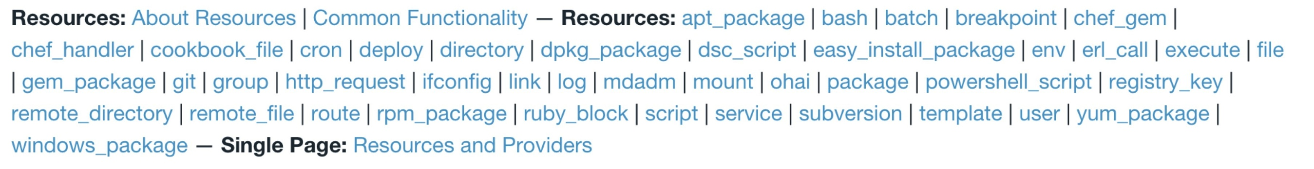
What resource should we use?
cookbook_file
file
remote_file
template

Slide 132
cookbook_file
A file stored in the cookbook contains the content of the file.
motd
├── Berksfile
├── README.md
├── chefignore
├── files
│ └── default
│ └── motd
├── metadata.rb
├── recipes
└── default.rb

Slide 133
file
The content is described inline in the recipe
file "/etc/motd" do
content "Property of COMPANY NAME"
action :create
mode "0644"
owner "root"
group "root"
end

Slide 134
remote_file
The file is stored in a remote location, such as on the web
file "/etc/motd" do
url "http://some.where.com/motd"
action :create
mode "0644"
owner "root"
group "root"
end

Slide 135
template
A template file is stored as part of the cookbook
motd
├── Berksfile
├── README.md
├── chefignore
├── metadata.rb
├── recipes
│ └── default.rb
└── templates
└── default
└── motd.erb

Slide 136
template
A template file is stored as part of the cookbook and rendered to create the file.
motd/templates/default/motd.erb
Property of <%= @company_name %>

Slide 137
Which resource should we use?
cookbook_file – static file, within the cookbook
file – content managed inline
remote_file – static file, obtained from a URL
template – dynamic content based on ERB template
Notes:
TODO – Add visuals for each

Slide 138
Template Resource
An ERB template stored as part of our cookbook

Slide 139
Update the recipe
~/chef-repo/motd/recipes/default.rb
#
# Cookbook Name:: motd
# Recipe:: default
#
# Copyright (c) 2014 The Authors, All Rights Reserved.
template ”/etc/motd" do
action :create
source "motd.erb"
mode ”0644"
owner "root"
group "root"
end

Slide 140
Create the ERB template
chef generate template --help
Usage: chef generate template [path/to/cookbook] NAME [options]
-C, --copyright COPYRIGHT Name of the copyright holder - defaults to 'The Authors'
-m, --email EMAIL Email address of the author - defaults to 'you@example.com'
-I, --license LICENSE all_rights, apache2, mit, gplv2, gplv3 - defaults to all_rights
-s, --source SOURCE_FILE Copy content from SOURCE_FILE
-g GENERATOR_COOKBOOK_PATH, Use GENERATOR_COOKBOOK_PATH for the code_generator cookbook
--generator-cookbook

Slide 141
Go to the motd cookbook directory
cd ~/chef-repo/cookbooks/motd

Slide 142
Create the ERB template
chef generate template . motd -s /etc/motd
Compiling Cookbooks...
Recipe: code_generator::template
* directory[././templates/default] action create
- create new directory ././templates/default
* file[././templates/default/motd.erb] action create
- create new file ././templates/default/motd.erb
- update content in file ././templates/default/motd.erb from none to 315f5b
(diff output suppressed by config)

Slide 143
Check the template
~/chef-repo/cookbooks/motd/templates/default/motd.erb
Property of COMPANY NAME

Slide 144
chef-apply
chef-apply does not understand cookbooks, only resources and recipes
We cannot use chef-apply to apply the policy stored in our motd cookbook

Slide 145
chef-client
chef-client is an executable
performs all actions required to bring the node into the desired state
typically run on a regular basis
daemon
cron
Windows service
Included with ChefDK

Slide 146
chef-client applying policies
Node

Slide 147
chef-client applying policies
chef-client
Node

Slide 148

chef-client applying policies
chef-client
What policy should I follow?
Node

Slide 149
chef-client applying policies
chef-client
What policy should I follow?
Node
Test & Repair
Apply the policy

Slide 150
chef-client applying policies repeatedly
chef-client
What policy should I follow?
Node
Test & Repair
Apply the policy
Node

Slide 151
chef-client applying policies repeatedly
chef-client
What policy should I follow?
Node
Test & Repair
Apply the policy
chef-client
Node

Slide 152
chef-client applying policies repeatedly
chef-client
What policy should I follow?
Node
Test & Repair
Apply the policy
chef-client
What policy should I follow?
Node

Slide 153
chef-client applying policies repeatedly
chef-client
What policy should I follow?
Node
Test & Repair
Apply the policy
chef-client
What policy should I follow?
Node
Test & Repair
Apply the policy

Slide 154
chef-client modes
In conjunction with a Chef Server
Local mode (no Chef Server)

Slide 155
chef-client privileges
Usually run with elevated privileges
root
sudo
Administrator
Can run as a normal user

Slide 156
Apply our recipe using chef-client
cd ~/chef-repo

Slide 157
Apply our recipe using chef-client
sudo chef-client --local-mode -r "recipe[motd]"
[2014-12-02T15:13:21+00:00] WARN: No config file found or specified on command line, using command line options.
Starting Chef Client, version 11.18.0.rc.1
resolving cookbooks for run list: ["motd"]
Synchronizing Cookbooks:
- motd
Compiling Cookbooks...
Converging 1 resources
Recipe: motd::default
* template[/etc/motd] action create
- update content in file /etc/motd from 4fe2f6 to e989a4
(no diff)
- restore selinux security context
Running handlers:
Running handlers complete
Chef Client finished, 1/1 resources updated in 3.346092479 seconds

Slide 158
chef-client applying policies
chef-client
What policy should I follow?
Node
Test & Repair
Apply the policy
recipe[motd]
recipe[motd]

Slide 159
Lab 4 – Manage Data & Policy Separately
Install git?
Create a chef-repo
Create a cookbook

Slide 160
Separating data from policy
Storing the file’s content directly in the recipe feels wrong
We can manage that content separately using a different resource
cookbook_file
remote_file
template

Slide 161
Template resource
An ERB template that is used to generate files based on the variables and logic contained within the template.

Slide 162
What if…?
The contents of motd should be pulled from a file in an s3 bucket?
The motd file should have variable content?

Slide 163
Lab 5 – Manage ntp
Create a cookbook that will manage ntp
Use a template to manage /etc/ntp.conf
Initially, the file’s content needn’t change from the defaults
Packages for ntp on CentOS are
ntp
ntpdate

Slide 164
Describing Policies
Describe the relationship between resource, recipes, and cookbooks?
What types of files might you find in a cookbook?
Where is the version of a cookbook specified?

Slide 165
Describing Policies
What questions can I answer for you?

Slide 166
A Sandbox for Testing
Test Kitchen

Slide 167
Our process
Write policy
Apply policy
Verify policy
Not bad for the simple case, will quickly get untenable

Slide 168
Faster Feedback
Speed-up the feedback loops with automated testing.
Have confidence in your changes before you run them in production

Slide 169
The pedantries of testing
Unit testing
Integration testing
Acceptance testing
Functional testing
Regression testing
Smoke testing
Load testing
Notes:
I don’t want to get bogged down in the various types of testing. It’s not something that’s going to help us today.

Slide 170
Chef Testing
Did chef-client complete successfully?
Did the recipe put the node in the desired state?
Are the resources properly defined?
Does the code follow our style guide?

Slide 171
Test-driving infrastructure
We are going to use a relatively simple scenario
We are going to explore many facets of testing
We are going to follow a test-first, test-driven model

Slide 172
Our Scenario
We want a custom home page available on the web.

Slide 173
Lab 6 – Create a Sandbox Environment
Problem: Applying recipes directly to our workstation is akin to making changes directly in production. We should NOT do that!
Success Criteria: We have an isolated environment to verify the success status of a chef-client run

Slide 174
Create an apache cookbook
cd ~/chef-repo/cookbooks

Slide 175
Create an apache cookbook
chef generate cookbook apache
Compiling Cookbooks...
Recipe: code_generator::cookbook
* directory[/home/chef/chef-repo/cookbooks/apache] action create
- create new directory /home/chef/chef-repo/cookbooks/apache
- restore selinux security context
* template[/home/chef/chef-repo/cookbooks/apache/metadata.rb] action create_if_missing
- create new file /home/chef/chef-repo/cookbooks/apache/metadata.rb
- update content in file /home/chef/chef-repo/cookbooks/apache/metadata.rb from none to 4c0e2d
(diff output suppressed by config)
- restore selinux security context
* template[/home/chef/chef-repo/cookbooks/apache/README.md] action create_if_missing
- create new file /home/chef/chef-repo/cookbooks/apache/README.md
- update content in file /home/chef/chef-repo/cookbooks/apache/README.md from none to 5c3d3a
(diff output suppressed by config)
- restore selinux security context
* cookbook_file[/home/chef/chef-repo/cookbooks/apache/chefignore] action create
…

Slide 176
Create an apache cookbook
cd apache

Slide 177
Create an apache cookbook
git add .

Slide 178
Create an apache cookbook
git commit –m “initial apache cookbook”

Slide 179
Chef client success status
Requirements to verify chef-client success:
A target server running the same OS as production

Slide 180
Chef client success status
Requirements to verify chef-client success:
A target server running the same OS as production
A chef-client with access to the cookbook

Slide 181

Test Kitchen
Test harness to execute code on one or more platforms
Driver plugins to allow your code to run on various cloud and virtualization providers
Includes support for many testing frameworks
Included with ChefDK

Slide 182
Test Matrix
Two operating systems
ubuntu-12.04
centos-6.4

Slide 183
Test Matrix
Two operating systems
One recipe
 | default
ubuntu-12.04 | apache::default
centos-6.4 | apache::default

Slide 184
Test Matrix
Two operating systems
Two recipes
 | default | ssl
ubuntu-12.04 | apache::default | apache::ssl
centos-6.4 | apache::default | apache::ssl

Slide 185
Test Matrix
Three operating systems
Two recipes
 | default | ssl
ubuntu-12.04 | apache::default | apache::ssl
centos-6.4 | apache::default | apache::ssl
ubuntu-14.04 | apache::default | apache::ssl

Slide 186
Configuring the Kitchen
apache/.kitchen.yml
---
driver:
name: vagrant
provisioner:
name: chef_zero
platforms:
- name: ubuntu-12.04
- name: centos-6.4
suites:
- name: default
run_list:
- recipe[apache::default]
attributes:

Slide 187
.kitchen.yml
driver - virtualization or cloud provider
---
driver:
name: vagrant
provisioner:
name: chef_zero
platforms:
- name: ubuntu-12.04
- name: centos-6.4
suites:
- name: default
run_list:
- recipe[apache::default]
attributes:

Slide 188
.kitchen.yml
provisioner - application to configure the node
---
driver:
name: vagrant
provisioner:
name: chef_zero
platforms:
- name: ubuntu-12.04
- name: centos-6.4
suites:
- name: default
run_list:
- recipe[apache::default]
attributes:

Slide 189
.kitchen.yml
platforms - target operating systems
---
driver:
name: vagrant
provisioner:
name: chef_zero
platforms:
- name: ubuntu-12.04
- name: centos-6.4
suites:
- name: default
run_list:
- recipe[apache::default]
attributes:

Slide 190
.kitchen.yml
suites - target configurations
---
driver:
name: vagrant
provisioner:
name: chef_zero
platforms:
- name: ubuntu-12.04
- name: centos-6.4
suites:
- name: default
run_list:
- recipe[apache::default]
attributes:

Slide 191
.kitchen.yml
 | default
ubuntu-12.04 | apache::default
centos-6.4 | apache::default
---
driver:
name: vagrant
provisioner:
name: chef_zero
platforms:
- name: ubuntu-12.04
- name: centos-6.4
suites:
- name: default
run_list:
- recipe[apache::default]

Slide 192
.kitchen.yml
 | default | ssl
ubuntu-12.04 | apache::default | apache::ssl
centos-6.4 | apache::default | apache::ssl
---
driver:
name: vagrant
provisioner:
name: chef_zero
platforms:
- name: ubuntu-12.04
- name: centos-6.4
suites:
- name: default
run_list:
- recipe[apache::default]
- name: ssl
run_list:
- recipe[apache::ssl]

Slide 193
.kitchen.yml
 | default | ssl
ubuntu-12.04 | apache::default | apache::ssl
centos-6.4 | apache::default | apache::ssl
ubuntu-14.04 | apache::default | apache::ssl
---
driver:
name: vagrant
provisioner:
name: chef_zero
platforms:
- name: ubuntu-12.04
- name: centos-6.4
- name: ubuntu-14.04
suites:
- name: default
run_list:
- recipe[apache::default]
- name: ssl
run_list:
- recipe[apache::ssl]

Slide 194
.kitchen.yml
The configuration file for your Test Kitchen
driver – virtualization or cloud provider
provisioner – application to configure the node
platforms – target operating systems
suites – target configurations

Slide 195
Update .kitchen.yml
cookbooks/apache/.kitchen.yml
---
driver:
name: docker
provisioner:
name: chef_zero
platforms:
- name: centos-6.5
suites:
- name: default
run_list:
- recipe[apache::default]
attributes:

Slide 196

Docker
Portable, lightweight application runtime
Linux containers
Installed on the workstation
https://d3oypxn00j2a10.cloudfront.net/0.10.3/img/homepage/docker-whale-home-logo-@2x.png?cf34b4b2b839

Slide 197
Verify docker
sudo docker images
REPOSITORY TAG IMAGE ID CREATED VIRTUAL SIZE
centos centos6 70441cac1ed5 6 days ago 215.8 MB
ubuntu 12.04 0b310e6bf058 2 weeks ago 116.1 MB
Notes:
The images were installed using: sudo docker pull cetos

Slide 198
kitchen-docker gem
A driver that allows Test Kitchen to work with Docker
Installed on the workstation
ChefDK includes kitchen-vagrant

Slide 199
Verify kitchen-docker is installed
gem list kitchen
*** LOCAL GEMS ***
kitchen-docker (1.5.0)
kitchen-vagrant (0.15.0)
test-kitchen (1.2.1)

Slide 200
Move to the apache cookbook directory
cd ~/chef-repo/cookbooks/apache

Slide 201
List the Test Kitchens
kitchen list
Instance Driver Provisioner Last Action
default-centos-65 Docker ChefZero <Not Created>

Slide 202
Create the kitchen
kitchen create
-----> Starting Kitchen (v1.2.1)
-----> Creating <default-centos-64>...
Step 0 : FROM centos:centos6
---> 68eb857ffb51
Step 1 : RUN yum clean all
---> Running in cdf3952a3f18
Loaded plugins: fastestmirror
Cleaning repos: base extras libselinux updates
Cleaning up Everything
---> b1cccd25ce55
Removing intermediate container cdf3952a3f18
Step 2 : RUN yum install -y sudo openssh-server openssh-clients which curl
---> Running in 9db69ace459d
Loaded plugins: fastestmirror

Slide 203
Kitchen created
Workstation
Kitchen

Slide 204
Login to the kitchen
kitchen login
kitchen@localhost's password:

Slide 205
Login to the kitchen
kitchen login
kitchen@localhost's password:
kitchen

Slide 206
Login to the kitchen
kitchen login
kitchen@localhost's password:
Last login: Wed Sep 24 04:30:29 2014 from 172.17.42.1
kitchen

Slide 207
Kitchen login
Workstation
Kitchen

Slide 208
Kitchen login
Workstation
Kitchen
[chef@ip-172-31-44-173 apache]$ kitchen login

Slide 209
Kitchen login
Workstation
Kitchen
ssh
[chef@ip-172-31-44-173 apache]$ kitchen login

Slide 210
Kitchen login
Workstation
Kitchen
[kitchen@5379d310dc59 ~]$
ssh
[chef@ip-172-31-44-173 apache]$ kitchen login

Slide 211
Chef client success status
Requirements to verify chef-client success:
A target server running the same OS as production
A chef-client with access to the cookbook

Slide 212
Lab 7 – Apply our policy
Problem: We have not applied our policy to the test environment.
Success Criteria: The default apache recipe will be applied in the test environment

Slide 213
Leave the kitchen
exit
logout
Connection to localhost closed.

Slide 214
Go to the right place
cd ~/chef-repo/cookbooks/apache

Slide 215
Apply our policy
kitchen converge
-----> Starting Kitchen (v1.2.1)
-----> Converging <default-centos-64>...
Preparing files for transfer
Resolving cookbook dependencies with Berkshelf 3.1.5...
Removing non-cookbook files before transfer
-----> Installing Chef Omnibus (true)
downloading https://www.getchef.com/chef/install.sh
to file /tmp/install.sh
trying curl...

Slide 216
Kitchen converge
Workstation
Kitchen
Install Chef
Upload cookbooks
Apply the run_list

Slide 217
Status Check
Success Criteria: We have an isolated environment to verify the success status of a chef-client run
Success Criteria: The default apache recipe will be applied in the test environment

Slide 218
Chef Testing
Did chef-client complete successfully?
Did the recipe put the node in the desired state?
Are the resources properly defined?
Does the code following our style guide?

Slide 219
Chef Testing
Did chef-client complete successfully?
Did the recipe put the node in the desired state?
Are the resources properly defined?
Does the code following our style guide?

Slide 220
Test Kitchen
What is a driver?
What is a provisioner?
What are platforms?
What are suites?

Slide 221
Kitchen Commands
kitchen list
kitchen create
kitchen converge
kitchen login

Slide 222
Lab 8 – Create kitchen for motd
Update Test Kitchen for the motd cookbook
Use kitchen-docker driver
Only text CentOS
Create the Test Kitchen

Slide 223
What if…?
You wanted to test our recipe on Ubuntu as well as CentOS?
You wanted to remove the kitchen sandbox?
Did not have Docker installed?

Slide 224
Test Kitchen
What questions can I answer for you?

Slide 225
Verifying node state
Serverspec

Slide 226
Chef Testing
Did chef-client complete successfully?
Did the recipe put the node in the desired state?
Are the resources properly defined?
Does the code following our style guide?

Slide 227
Manually inspect the test node
kitchen login
kitchen@localhost's password:

Slide 228
Manually inspect the test node
kitchen login
kitchen@localhost's password:
kitchen

Slide 229
Manually inspect the test node
kitchen login
kitchen@localhost's password:
Last login: Wed Sep 24 04:30:29 2014 from 172.17.42.1
kitchen

Slide 230
Manually inspect the test node
curl http://localhost
curl: (7) couldn't connect to host

Slide 231
Kitchen login
Workstation
Kitchen
[kitchen@5379d310dc59 ~]$ curl http://localhost
curl: (7) couldn't connect to host
ssh
[chef@ip-172-31-44-173 apache]$ kitchen login

Slide 232
Lab 9 – Verify node state
Problem: Manually verifying the state of the test node is tedious and error-prone.
Success Criteria: The end state of the node is automatically tested.

Slide 233

Serverspec
Write tests to verify your servers
Not dependent on Chef
Defines many resource types
package, service, user, etc.
Works well with Test Kitchen
http://serverspec.org/

Slide 234
Leave the Kitchen
exit
logout
Connection to localhost closed.

Slide 235
Move to the proper directory
cd ~/chef-repo/cookbooks/apache

Slide 236
Create directory for serverspec tests
mkdir -p test/integration/default/serverspec
Notes:
TODO – kitchen script we could run here?

Slide 237
Default location for tests
Test Kitchen will look in the test/integration directory for test-related files

Slide 238
Suite subdirectory
The next level subdirectory will match the suite name.
test/
└── integration
└── default
└── serverspec
└── default_spec.rb
suites:
- name: default
run_list:
- recipe[apache::default]

Slide 239
Suite subdirectory
The next level subdirectory will match the suite name.
test/
└── integration
└── default
└── serverspec
└── default_spec.rb
suites:
- name: default
run_list:
- recipe[apache::default]

Slide 240
Busser subdirectory
Test Kitchen utilizes bussers to manage test plugins.
We’ll be using the serverspec plugin
test/
└── integration
└── default
└── serverspec
└── default_spec.rb
suites:
- name: default
run_list:
- recipe[apache::default]

Slide 241
Write a Serverspec test
test/integration/default/serverspec/default_spec.rb
require 'serverspec'
set :backend, :exec
describe 'apache' do
end

Slide 242
Generic Expectation Form
describe "<subject>" do
it "<description>" do
expect(thing).to eq result
end
end
Notes:
TODO: Use proper syntax / terms

Slide 243
Awesome Expectations
test/integration/default/serverspec/default_spec.rb
require 'serverspec'
set :backend, :exec
describe "apache" do
it "is awesome" do
expect(true).to eq true
end
end

Slide 244
Run the serverspec test
kitchen verify
-----> Running serverspec test suite
/opt/chef/embedded/bin/ruby -I/tmp/busser/suites/serverspec -I/tmp/busser/gems/gems/rspec-support-3.1.2/lib:/tmp/busser/gems/gems/rspec-core-3.1.7/lib /opt/chef/embedded/bin/rspec --pattern /tmp/busser/suites/serverspec/\*\*/\*_spec.rb --color --format documentation --default-path /tmp/busser/suites/serverspec
apache
is awesome
Finished in 0.02823 seconds (files took 0.99875 seconds to load)
1 example, 0 failures
Finished verifying <default-centos-64> (0m5.03s).

Slide 245
How would you test our criteria?
We want a custom home page available on the web.

Slide 246
What is success?
Package is installed?
Page is displayed?
What else?

Slide 247
Verify package is installed
test/integration/default/serverspec/default_spec.rb
require 'serverspec'
set :backend, :exec
describe "apache" do
it "is awesome" do
expect(true).to eq true
end
it "is installed" do
expect(package("httpd")).to be_installed
end
end
Notes:
add the it stanzas for the rest of the things and see them in a pending state
describe 'apache' do
…
it "is running"
it "is configured to run when the server reboots"
it "displays our home page"
it "returns a proper response code"
it "is listening on the proper port"
end

Slide 248
Exercise the test
kitchen verify
apache
is awesome
is installed (FAILED - 1)
Failures:
1) apache is installed
Failure/Error: expect(package("httpd")).to be_installed
expected Package "httpd" to be installed
/bin/sh -c rpm\ -q\ httpd
package httpd is not installed

Slide 249
Test is failing, make it pass
Test-driven development involves
Write a test to verify something is working
Watch the test fail
Write just enough code to make the test pass
Repeat

Slide 250
Update our cookbook
~/chef-reop/cookbooks/apache/recipes/default.rb
package "httpd"

Slide 251
Converge the node again
kitchen converge
-----> Converging <default-centos-64>...
Preparing files for transfer
Resolving cookbook dependencies with Berkshelf 3.1.5...
Removing non-cookbook files before transfer
Transfering files to <default-centos-64>
[2014-11-10T09:20:26+00:00] INFO: Starting chef-zero on host localhost, port 8889 with repository at repository at /tmp/kitchen
One version per cookbook
[2014-11-10T09:20:26+00:00] INFO: Forking chef instance to converge...
Starting Chef Client, version 11.16.4
[2014-11-10T09:20:27+00:00] INFO: *** Chef 11.16.4 ***
[2014-11-10T09:20:27+00:00] INFO: Chef-client pid: 571
...

Slide 252
Exercise the test
kitchen verify
apache
is awesome
is installed
Finished in 0.48165 seconds (files took 1.05 seconds to load)
2 examples, 0 failures
Finished verifying <default-centos-64> (0m5.64s).
-----> Kitchen is finished. (0m11.84s)

Slide 253
What else will you test?
Is the service running?
Is the port accessible?
Is the expected content being served?
Make sure everything works from a fresh kitchen, too!
Notes:
As the students answer the questions add tests to your serverspec. It might look something like this which will work and show the tests a “pending”
describe 'apache' do
it "is awesome" do
expect(true).to eq true
end
it "is installed" do
expect(package "httpd").to be_installed
end
it "is running"
it "is configured to run when the server reboots"
it "displays our home page"
it "returns a proper response code"
it "is listening on the proper port"
end

Slide 254

Time to hack!
https://www.flickr.com/photos/peterpearson/424047087
Notes:
Go!
Get started on your own, let’s check-in again in 20 minutes or so.
require 'serverspec'
require 'net/http' # required for the NET::HTTP test
set :backend, :exec
describe 'apache' do
it "is awesome" do
expect(true).to eq true
end
it "is installed" do
expect(package "httpd").to be_installed
end
it "is running" do
expect(service "httpd").to be_running
end
it "is configured to run when the server reboots" do
expect(service "httpd").to be_enabled
end
it "displays our home page" do
expect(command("curl http://localhost").stdout).to match /hello/i
end
it "returns a proper response code" do
expect(Net::HTTP.get_response(URI('http://localhost/index.html')).code).to eq "200”
expect(command('curl -sL -w "%{http_code}" "http://localhost" -o /dev/null').stdout).to eq "200” #man, that’s ugly! But it removes the requirement on net/http
end
it "is listening on the proper port" do
expect(port "80").to be_listening.with("tcp")
end
end

Slide 255
Extend the Serverspec test
test/integration/default/serverspec/default_spec.rb
describe 'apache' do
it "is installed" do
expect(package 'httpd').to be_installed
end
it "is running" do
expect(service 'httpd').to be_running
end
it "is listening on port 80" do
expect(port 80).to be_listening
end
it "displays a custom home page" do
expect(command("curl localhost").stdout).to match /hello/
end
end

Slide 256
Verify the kitchen
kitchen verify
apache
is installed
is running
is listening on port 80
displays a custom home page
Finished in 0.3968 seconds
4 examples, 0 failures
Finished verifying <default-centos-64> (0m4.25s).

Slide 257
Kitchen Workflow
kitchen create
kitchen converge
kitchen verify
kitchen destroy
All at once with kitchen test

Slide 258
Chef Testing
Did chef-client complete successfully?
Did the recipe put the node in the desired state?
Are the resources properly defined?
Does the code following our style guide?

Slide 259
Lab 10 – Verify node state in motd
Add serverspec tests to your motd cookbook

Slide 260
Verifying the node
What command will show you the current state of your test kitchen suites?
Can you view your kitchen’s custom home page from your laptop’s browser? How? Why?
Is it important to start with a fresh kitchen?

Slide 261
Verifying Node State
What questions can I answer for you?

Slide 262
Even Faster Feedback
ChefSpec

Slide 263
Chef Testing
Did chef-client complete successfully?
Did the recipe put the node in the desired state?
Are the resources properly defined?
Does the code following our style guide?

Slide 264
This is too slow!
To test our code, we need to spin up a test kitchen, converge a node, execute some tests.
Our simple test case takes about 2 minutes to fully execute.

Slide 265
Properly configured resources
We need a way to verify that the resources in our recipes are properly configured
We want to get faster feedback

Slide 266
Lab 9 – Verify the resources
Problem: We should be able to catch errors before we need to converge a node
Success Criteria: Catch a typo prior to converge

Slide 267
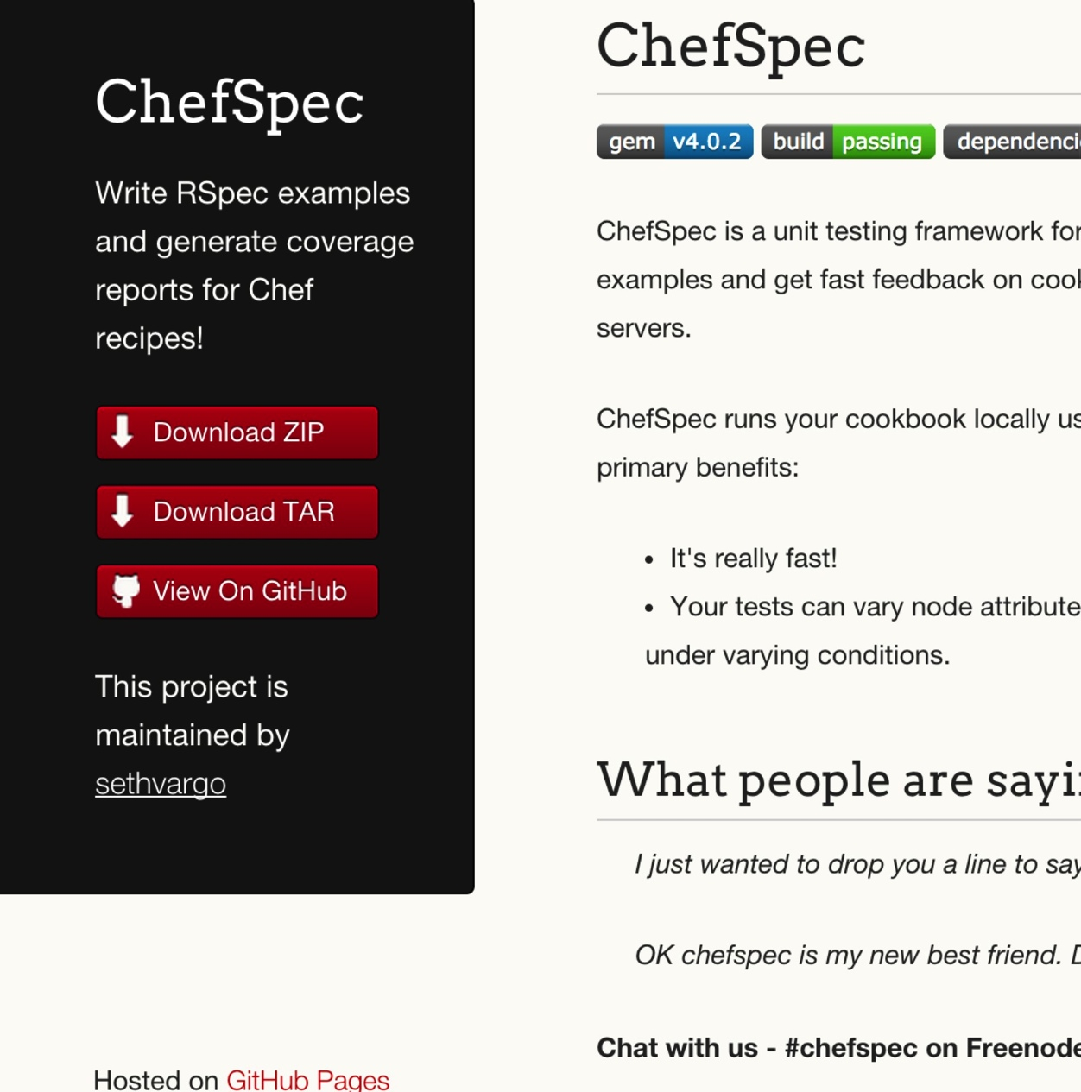
ChefSpec
Test before you converge
Get feedback on cookbook changes without the need for target servers
http://sethvargo.github.io/chefspec/

Slide 268
Make a directory for our ChefSpec tests
cd ~/chef-repo/cookbooks/apache
Notes:
~/chef-repo/cookbooks/apache/

Slide 269
Make a directory for our ChefSpec tests
mkdir -p spec/unit
Notes:
~/chef-repo/cookbooks/apache/

Slide 270
Write a ChefSpec test
spec/unit/default.rb
require 'chefspec'
describe 'apache::default' do
let(:chef_run) do
ChefSpec::Runner.new.converge(described_recipe)
end
it 'installs apache' do
expect(chef_run).to install_package('httpd')
end
end

Slide 271
Run the ChefSpec tests
rspec spec/unit/*.rb
.
Finished in 0.00865 seconds (files took 5.5 seconds to load)
1 example, 0 failures

Slide 272
Break the cookbook
recipes/default.rb
package "http"
service "httpd" do
action :start
end
template "/var/www/html/index.html" do
source "index.html.erb"
end

Slide 273
Run the ChefSpec tests
rspec spec/unit/*.rb
F
Failures:
1) apache::default installs apache
Failure/Error: expect(chef_run).to install_package('httpd')
expected "package[httpd]" with action :install to be in Chef run. Other package resources:
package[http]
# ./spec/unit/default_spec.rb:9:in `block (2 levels) in <top (required)>'
Finished in 0.00847 seconds (files took 4.85 seconds to load)
1 example, 1 failure
Failed examples:
rspec ./spec/unit/default_spec.rb:8 # apache::default installs apache

Slide 274
Fix the cookbook
recipes/default.rb
package "httpd"
service "httpd" do
action :start
end
template "/var/www/html/index.html" do
source "index.html.erb"
end

Slide 275
Time to hack!
https://www.flickr.com/photos/peterpearson/424047087
Notes:
Go!
Get started on your own, let’s check-in again in 20 minutes or so.

Slide 276
Chef Testing
Did chef-client complete successfully?
Did the recipe put the node in the desired state?
Are the resources properly defined?
Does the code following our style guide?

Slide 277
ChefSpec
What is the primary difference between ChefSpec and ServerSpec?
Why use ChefSpec if you already have ServerSpec tests?
Do passing ChefSpec tests ensure your recipe will work?
How would you feel about removing some of your ServerSpec tests now that you have ChefSpec in place?

Slide 278
ChefSpec
What questions can I answer for you?

Slide 279
Clean code
Follow best practices, avoid mistakes

Slide 280

Foodcritic
Check cookbooks for common problems
Style, correctness, deprecations, etc.
Included with ChefDK
http://www.foodcritic.io/

Slide 281
Change our recipe
recipes/default.rb
package_name = "httpd"
package "#{package_name}"
service "httpd" do
action :start
end
template "/var/www/html/index.html" do
source "index.html.erb"
end

Slide 282
Run Foodcritic
foodcritic .
FC002: Avoid string interpolation where not required: ./recipes/default.rb:7

Slide 283
Chef Testing
Did chef-client complete successfully?
Did the recipe put the node in the desired state?
Are the resources properly defined?
Does the code following our style guide?

Slide 284
Foodcritic
What rules have been deprecated?
What does Foodcritic return on success?

Slide 285
Foodcritic
What questions can I answer for you?

Slide 286
Wrap Up

Slide 287
Course Objectives
After completing this course you will be able to:
Automate common infrastructure tasks with Chef
Verify your automation code BEFORE it runs in production
Describe Chef’s various tools
Apply Chef’s primitives to solve your problems

Slide 288
Tool Survey
chef-apply
chef
chef-client in local mode
Test Kitchen
Docker
Serverspec
ChefSpec
Foodcritic

Slide 289
Vocabulary
Resources
Recipes
Cookbooks

Slide 290
Resources
Package
Service
File
Template

Slide 291
But wait…
…there’s more, so much more!
How much time do we have left? I could go on for days!

Slide 292
Further Resources
learnchef.com
Guided tutorials
Chef Fundamental Series
Upcoming Training
chef.io/blog/events/category/training-events/

Slide 293
Chef Fundamentals Q & A Forum
Chef Fundamentals Google Group Q&A Forum
http://bit.ly/ChefFundamentalsForum
Join the group and post questions

Slide 294
A list of URLs
http://chef.io
http://docs.chef.io
http://supermarket.chef.io
http://youtube.com/getchef
http://lists.opscode.com
irc.freenode.net: #chef, #chef-hacking
Twitter: @chef #getchef, @learnchef #learnchef

Slide 295
Food Fight Show
foodfightshow.org
Podcast where DevOps Chefs Do Battle
Best practices for working with Chef

Slide 296
What questions do you have?
Chef Server
Roles
Environments
Data Bags
Bootstrapping new nodes
Thank You!
Open source projects
Working with IaaS providers
chef-provisioner
Search
@tekbuddha

Slide 297
What else would you like to work on?
Make the cookbook work for ubuntu?
Explore Chef Server
Learn about other top-level Chef Objects
Node
Roles
Environments
Data Bags

Slide 298
Time to hack!
https://www.flickr.com/photos/peterpearson/424047087
Notes:
Go!
Get started on your own, let’s check-in again in 20 minutes or so.

Slide 299
Infrastructure State
The node object

Slide 300

Node Object
A node is a physical, virtual, or cloud machine that is managed by the chef-client
Node object is a data structure representing the state of a node
http://docs.chef.io/nodes.html

Slide 301
Node state
chef-client saves the current state of the node
Local mode – in the nodes directory
Normal mode – on the Chef server

Slide 302
New directory: nodes
ls ~/chef-repo/nodes
ip-172-31-32-114.ec2.internal.json
Notes:
~/chef-repo/nodes

Slide 303
Explore the node’s .json file
less nodes/*.json
{
"name": "ip-172-31-32-114.ec2.internal",
"normal": {
"tags": [
]
},
"automatic": {
"languages": {
"ruby": {
"platform": "x86_64-linux",
"version": "2.1.2",
"release_date": "2014-05-08",
"target": "x86_64-unknown-linux-gnu",
"target_cpu": "x86_64",
"target_vendor": "unknown",
"target_os": "linux",
"host": "x86_64-unknown-linux-gnu",
"host_cpu": "x86_64",
"host_os": "linux-gnu",
…
Notes:
wc ~/chef-repo/nodes/ip-172-31-41-194.ec2.internal.json

Slide 304
ohai
A system profiler that is used to detect the state of nodes
Platform
Network
Memory
And much more
Included with ChefDK

Slide 305
Run ohai
ohai | less
{
"languages": {
"ruby": {
"platform": "x86_64-linux",
"version": "2.1.2",
"release_date": "2014-05-08",
"target": "x86_64-unknown-linux-gnu",
"target_cpu": "x86_64",
"target_vendor": "unknown",
"target_os": "linux",
"host": "x86_64-unknown-linux-gnu",
"host_cpu": "x86_64",
"host_os": "linux-gnu",
"host_vendor": "unknown",
"bin_dir": "/opt/chefdk/embedded/bin",
"ruby_bin": "/opt/chefdk/embedded/bin/ruby",
"gems_dir": "/opt/chefdk/embedded/lib/ruby/gems/2.1.0",
"gem_bin": "/opt/chefdk/embedded/bin/gem"
},
…

Slide 306
Use ohai to find the platform
ohai platform
[
"centos"
]

Slide 307
Find the platform in the node object
grep '"platform"' nodes/*.json
"platform": "x86_64-linux",
"platform": "centos",

Slide 308
Lab 11 – Read node attributes in our policy
Problem: We want to see some node details on our home page.
Success Criteria: Our home page includes additional information about the node

Slide 309
Display node attributes
cookbooks/apache/templates/default/index.html.erb
<h1>hello world</h1>
<p>
This is a <%= node["platform"] %> <%= node["platform_version"] %> server.
with <%= node["memory"]["total"] %> RAM.
</p>

Slide 310
Display node attributes
cookbooks/apache/templates/default/index.html.erb
<h1>hello world</h1>
<p>
This is a <%= node["platform"] %> <%= node["platform_version"] %> server.
with <%= node["memory"]["total"] %> RAM.
</p>

Slide 311
Display node attributes
cookbooks/apache/templates/default/index.html.erb
<h1>hello world</h1>
<p>
This is a <%= node["platform"] %> <%= node["platform_version"] %> server.
with <%= node["memory"]["total"] %> RAM.
</p>

Slide 312
Display node attributes
cookbooks/apache/templates/default/index.html.erb
<h1>hello world</h1>
<p>
This is a <%= node["platform"] %> <%= node["platform_version"] %> server.
with <%= node["memory"]["total"] %> RAM.
</p>

Slide 313
Display node attributes
cookbooks/apache/templates/default/index.html.erb
<h1>hello world</h1>
<p>
This is a <%= node["platform"] %> <%= node["platform_version"] %> server.
with <%= node["memory"]["total"] %> RAM.
</p>

Slide 314
Verify the change
sudo chef-client -z -r "recipe[apache]"
Starting Chef Client, version 11.16.0
resolving cookbooks for run list: ["apache"]
Synchronizing Cookbooks:
- apache
Compiling Cookbooks...
Converging 3 resources
Recipe: apache::default
* package[httpd] action install (up to date)
* service[httpd] action start (up to date)
* template[/var/www/html/index.html] action create
- update content in file /var/www/html/index.html from cdf94d to 4ff592
--- /var/www/html/index.html 2014-09-23 13:28:23.912127556 +0000
+++ /tmp/chef-rendered-template20140924-11927-m0wkgp 2014-09-24 02:07:43.954127556 +0000
@@ -1,2 +1,8 @@
<h1>hello world</h1>
+
+<p>
+ This is a centos 6.5 server.
+ with 1695028kB RAM.
+</p>
+
- restore selinux security context
Running handlers:
Running handlers complete
Chef Client finished, 1/3 resources updated in 14.101936386 seconds

Slide 315
Verify the change
curl http://localhost
<h1>hello world</h1>
<p>
This is a centos 6.5 server.
with 1695028kB RAM.
</p>
Notes:
Might want / need to clarify node object vs. ohai
node object’s state is updated by chef-client
grep uptime nodes/*.json; ohai uptime; sleep 60; grep uptime nodes/*.json; ohai uptime
"uptime_seconds": 47716,
"uptime": "13 hours 15 minutes 16 seconds",
[
"13 hours 17 minutes 54 seconds"
]
"uptime_seconds": 47716,
"uptime": "13 hours 15 minutes 16 seconds",
[
"13 hours 18 minutes 55 seconds"
]

Slide 316
Custom node attributes
Ohai provides many attributes for the node object
You may want to include your own custom attributes

Slide 317
Lab 12 - Create a custom node attribute
Problem: We need a customized greeting on our home page.
Success Criteria: Our home page includes a custom greeting.

Slide 318
Lab 12 - Create a custom node attribute
Create the attribute
Display the attribute on the home page

Slide 319
chef can generate attributes
chef generate attribute --help
Usage: chef generate attribute [path/to/cookbook] NAME [options]
-C, --copyright COPYRIGHT Name of the copyright holder - defaults to 'The Authors'
-m, --email EMAIL Email address of the author - defaults to 'you@example.com'
-I, --license LICENSE all_rights, apache2, mit, gplv2, gplv3 - defaults to all_rights
-g GENERATOR_COOKBOOK_PATH, Use GENERATOR_COOKBOOK_PATH for the code_generator cookbook
--generator-cookbook

Slide 320
Generate attribute
chef generate attribute cookbooks/apache/ default
Compiling Cookbooks...
Recipe: code_generator::attribute
* directory[cookbooks/apache/attributes] action create
- create new directory cookbooks/apache/attributes
- restore selinux security context
* template[cookbooks/apache/attributes/default.rb] action create
- create new file cookbooks/apache/attributes/default.rb
- update content in file cookbooks/apache/attributes/default.rb from none to e3b0c4
(diff output suppressed by config)
- restore selinux security context

Slide 321
Create an attribute
cookbooks/apache/attributes/default.rb
default['apache']['greeting'] = "DC"
Notes:
Good practice to name space your attributes within the cookbook

Slide 322
Update the home page
cookbooks/apache/templates/default/index.html.erb
<h1>hello <%= node["apache"]["greeting"] %></h1>
<p>
This is a <%= node["platform"] %> <%= node["platform_version"] %> server.
with <%= node["memory"]["total"] %> RAM.
</p>

Slide 323
Verify the change
sudo chef-client -z -r "recipe[apache]"
Starting Chef Client, version 11.16.0
resolving cookbooks for run list: ["apache"]
Synchronizing Cookbooks:
- apache
Compiling Cookbooks...
Converging 3 resources
Recipe: apache::default
* package[httpd] action install (up to date)
* service[httpd] action start (up to date)
* template[/var/www/html/index.html] action create
- update content in file /var/www/html/index.html from 4ff592 to 470462
--- /var/www/html/index.html 2014-09-24 02:07:43.954127556 +0000
+++ /tmp/chef-rendered-template20140924-12185-11ypb0t 2014-09-24 02:25:25.833127556 +0000
@@ -1,4 +1,4 @@
-<h1>hello world</h1>
+<h1>hello DC</h1>
<p>
This is a centos 6.5 server.
- restore selinux security context
Running handlers:
Running handlers complete
Chef Client finished, 1/3 resources updated in 14.061031604 seconds

Slide 324
Verify the change
curl http://localhost
<h1>hello DC</h1>
<p>
This is a centos 6.5 server.
with 1695028kB RAM.
</p>
Notes:
Might want / need to clarify node object vs. ohai
node object’s state is updated by chef-client
grep uptime nodes/*.json; ohai uptime; sleep 60; grep uptime nodes/*.json; ohai uptime
"uptime_seconds": 47716,
"uptime": "13 hours 15 minutes 16 seconds",
[
"13 hours 17 minutes 54 seconds"
]
"uptime_seconds": 47716,
"uptime": "13 hours 15 minutes 16 seconds",
[
"13 hours 18 minutes 55 seconds"
]

